Slide 1
Puducherry colleges blog
Team members:
Aparna Bhaskaran
Deebak B
Girisankar G

Slide 2
Problem Statement
Every year more than 5,000 students are completing their Higher secondary education and joining colleges for higher studies.
In which most of the students are facing difficulties in getting Information about the College, despite being accessible online the information is all in conflict with one another.

Slide 3
Overview
Puducherry Colleges Blog offers information on colleges in Puducherry, including Courses offered, Fee structures, Placement details, hostel information, etc.
As a result of all the information being supplied in an organized manner via a blog, it is simpler for the students to select the college that best suits their needs.

Slide 4
Technology Stack
React JS
React Bootstrap
Spring Boot
Hibernate
Docker
draw.io
Figma

Slide 5
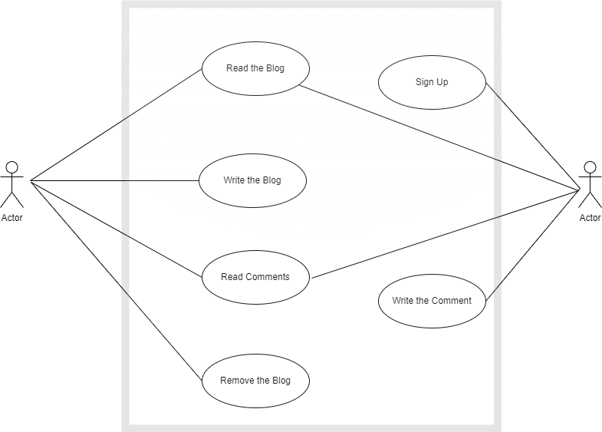
Use case Diagram
Blogger
User
user

Slide 6
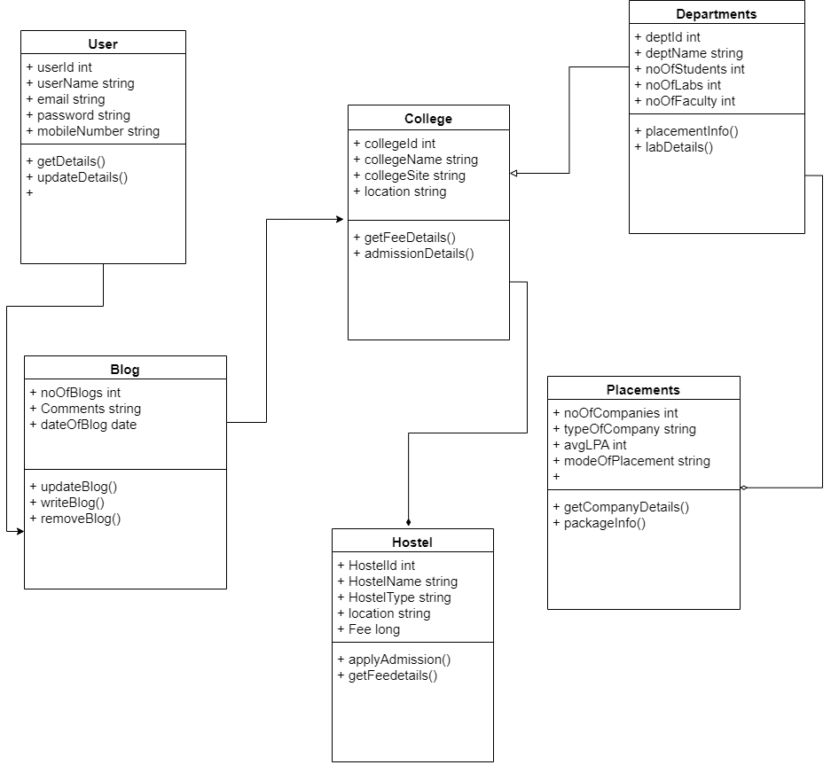
Class Diagram

Slide 7
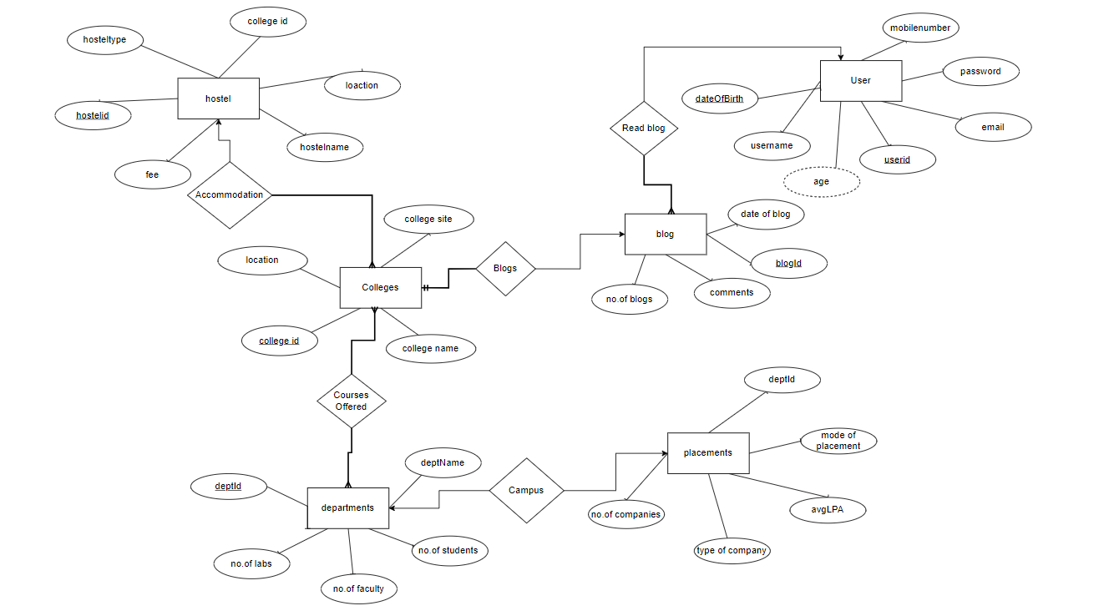
Entity Relationship Diagram

Slide 8
Microservices
We Created Three Microservices for this Application. Namely,
Blog Service(To fetch the blog details about respective colleges from the database)
Feedback Service(To allow users to enter feedbacks and store it and show it in front end)
Registration Service(User registration)

Slide 9
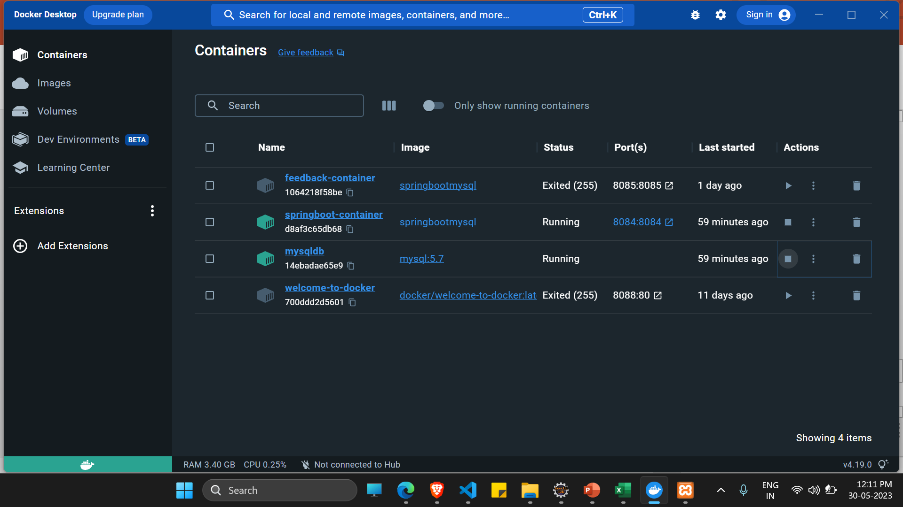
Dockers
We Used Docker to test the working of the Application on the production environment.
We Dockerised the Microservices with the Databases created on Docker and Configured the API’s for Docker.

Slide 10
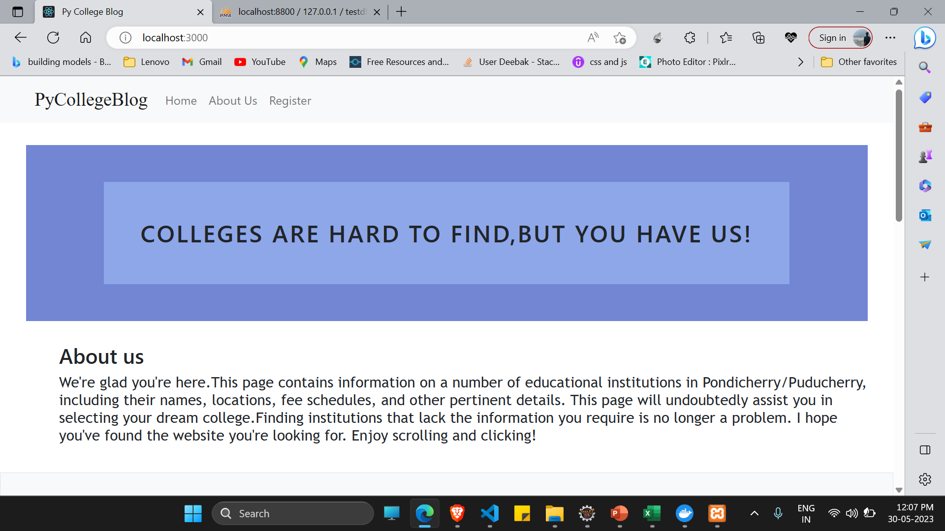
User Interface

Slide 11
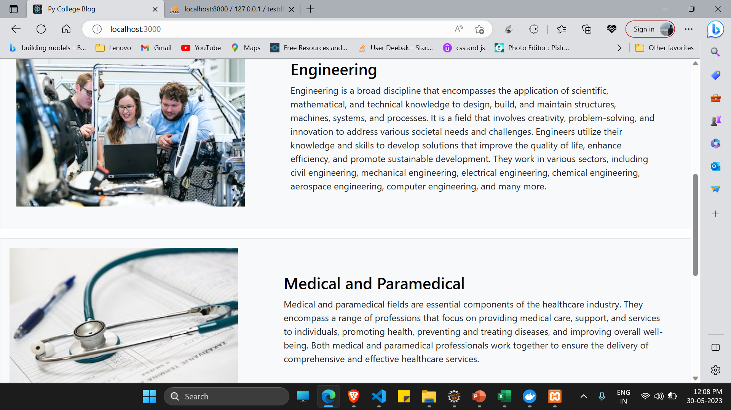

Slide 12
Testing and Code Coverage

Slide 13
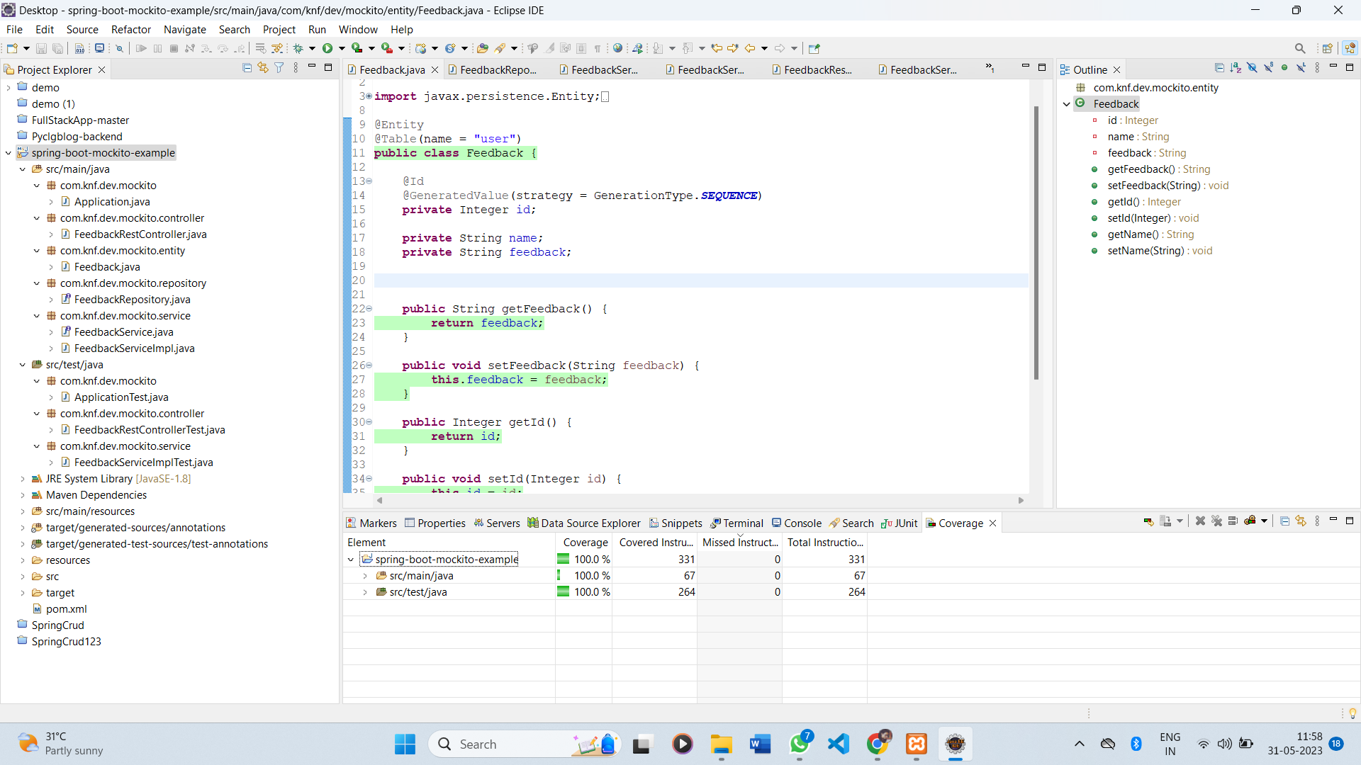
Feedback Service

Slide 14
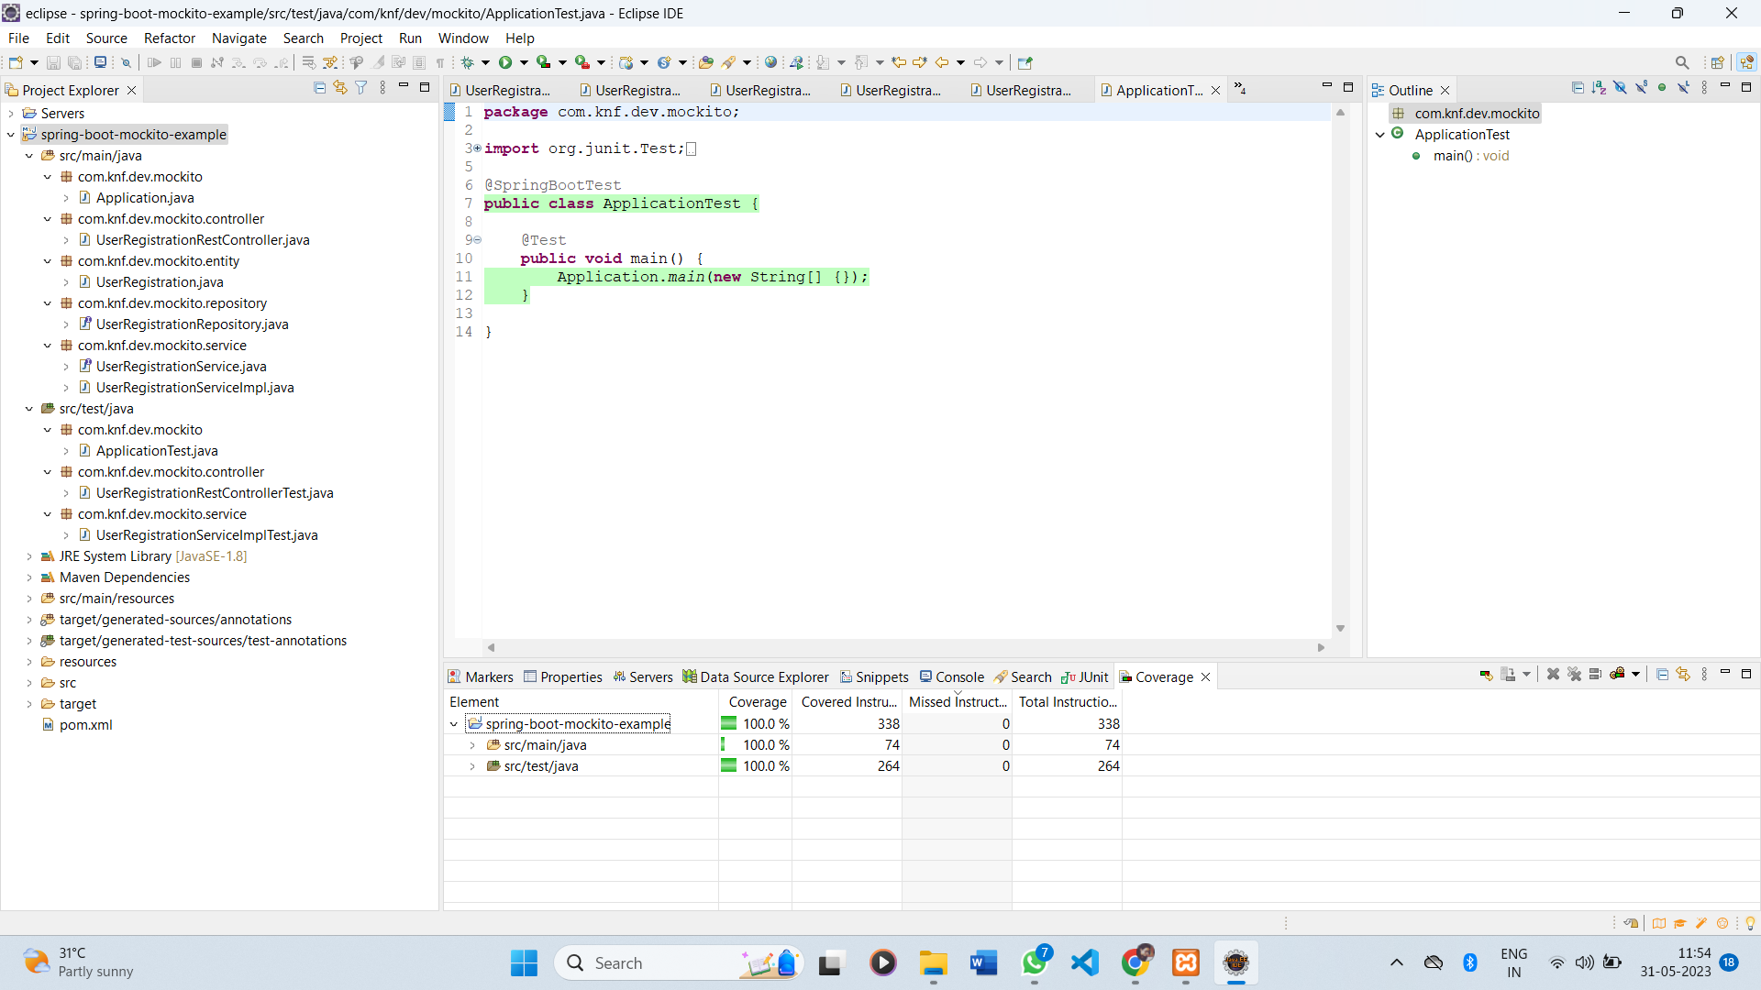
UserRegistration/Signup Service

Slide 15
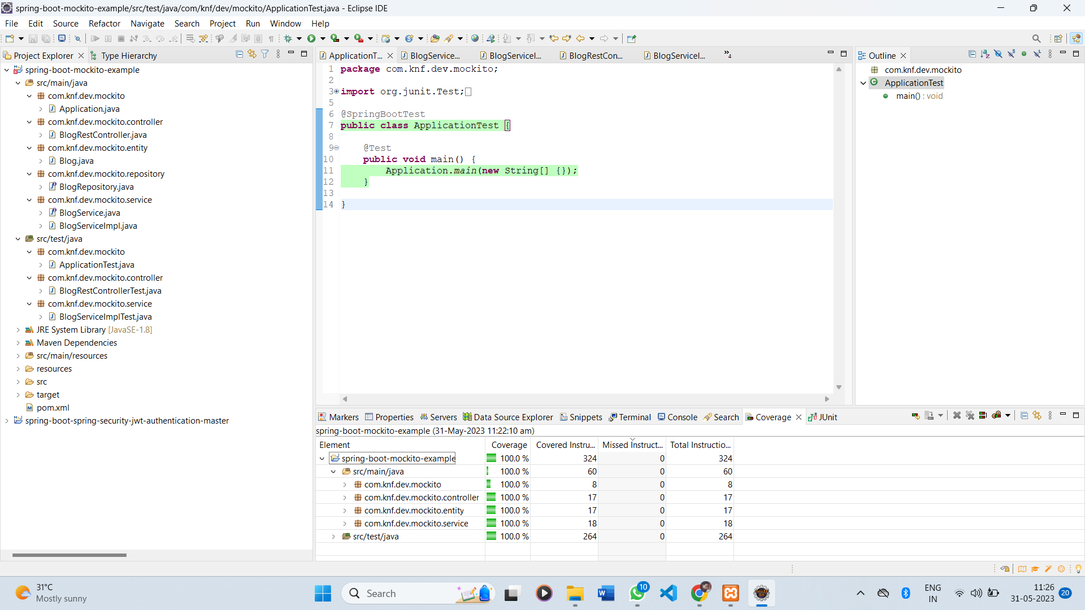
Blog Service

Slide 16
Future Enhancements
As the application we designed right now is a Minimum Viable Product, we intend to make future improvements as.
Use the actual information about the colleges rather than dummy texts and pictures of the colleges. To improve the application's features, we intend to develop a few more microservices.
The application will next be tested and hosted at a domain for public use.

Slide 17
Thank you
.

